Slide 1
ISO20022 update for GE community
June 20, 2025

Slide 2
Contingency measures for MT Senders
Starting 22 November 2025, the following FIN instruction message types sent bank-to-bank will be immediately Negatively Acknowledged (NAK/ed) and will not be delivered:
MT102, MT 102 STP, MT 103 REMIT, MT 201, MT 203.
Instruction message types: MT 103, MT 103 STP, MT 200, MT 202, MT 202 COV, MT 205, MT 205 COV (including MT Reject/Return codewords) sent bank-to-bank from 22 November 2025 will be subject to contingency processing, which consists of two steps:
FIN network validation will become stricter with the inclusion of additional rules that ensure the MT instruction can be fully and accurately converted to its ISO 20022 equivalent. Messages that fail validation will be NAK/ed, and no further processing will be performed.
Messages that pass the stricter network validation will be converted to their ISO 20022 equivalent and delivered to the receiver in ISO 20022 format via the InterAct FINplus service. The additional MT validation rules referred to in point 1 were published alongside Standards MT Release Guide 2025 on 13 December 2024. See details here.
The MT to ISO 20022 conversion capability should be considered a short-term contingency service of last resort and, as referenced above, will be chargeable. The price list can be found in in next slides or here Pricing and Invoicing - Price List for Swift Messaging and Solutions
Charges will not be included in Fixed Fee or Swift Essentials tariffs and will be reviewed at regular intervals.

Slide 3
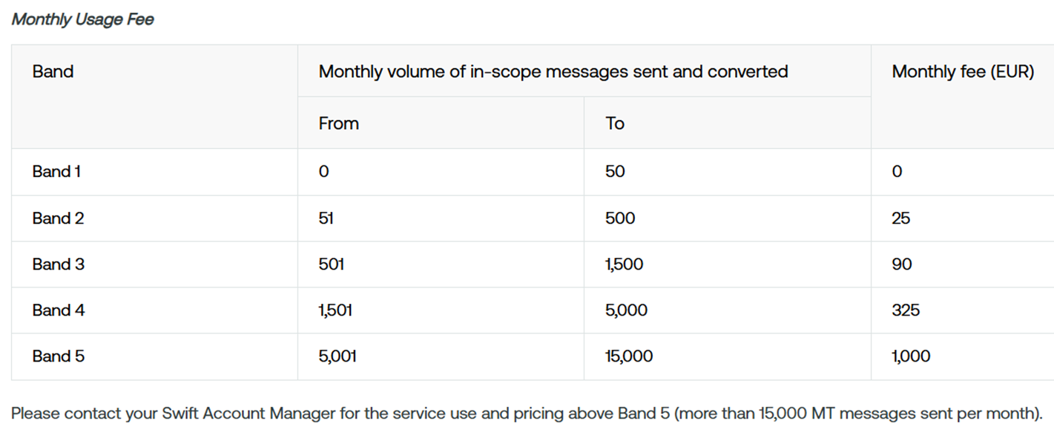
MT to ISO 20022 Conversion Service: For MT Senders (1/2)
All fees are applicable as from January 2026. Fees are charged at the level of the sending 8-character BIC on a monthly basis. The messages in scope are listed in KB Article 6000054.
BICs will be automatically enrolled to the Conversion Service upon sending qualifying MTs.
The total charge per BIC is the sum of a monthly usage fee based on volumes and monthly service fee based on Global Tier. The fees are not included in the fixed fee or Swift Essentials.
1. Monthly usage fee based on volumes (Band)

Slide 4
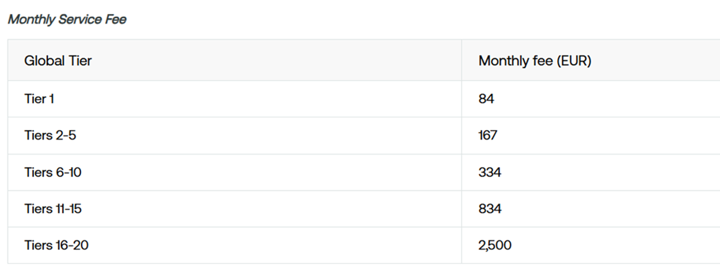
MT to ISO 20022 Conversion Service: For MT Senders (2/2)
2. Monthly Service Fee based on Global Tier
Importantly, conversion is only suitable for BIC8s sending low volumes of MT payment instructions (i.e. less than 15,000 MT payment instructions per month) and charges will apply based on global tier and volume of MT converted.
If the need for contingency processing above 15,000 MT payment instruction messages arises, institutions must engage with Swift to discuss contingency support needs that may be available for a short-term, controlled basis, at additional cost.

Slide 5
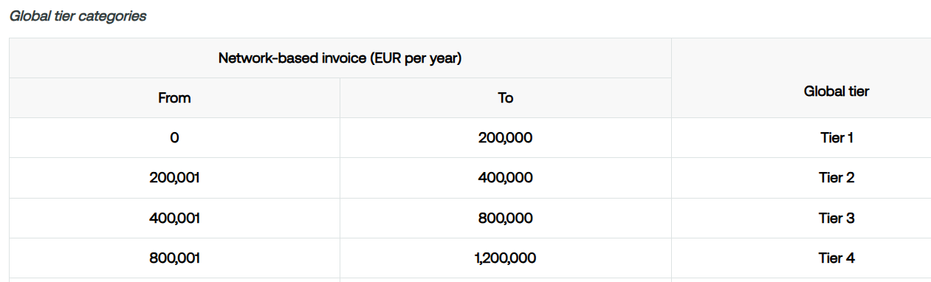
Global Tier
Global tier definition
The global tier is an index, ranging from 1 to 20, that is assigned to each financial institution. The global tier of a financial institution reflects the aggregated invoiced fees for the eligible services of that financial institution.
The global tier is used to determine the traffic and usage prices for the majority of SWIFT services. This is the case for, amongst other services, the FIN service, InterAct, FileAct, and various Solutions.
Global tier calculation
The global tier is calculated based on a financial institution's aggregated Network-based Invoice. The Network-based Invoice is the sum of the amounts invoiced to all SWIFT users that are part of the financial institution for the usage of the network-based SWIFT services (traffic) over the previous 12-month period. The rolling 12-month period alleviates the impact of seasonal effects and traffic anomalies.
Source: Price List for SWIFT Messaging and Solutions on MySWIFT

Slide 6
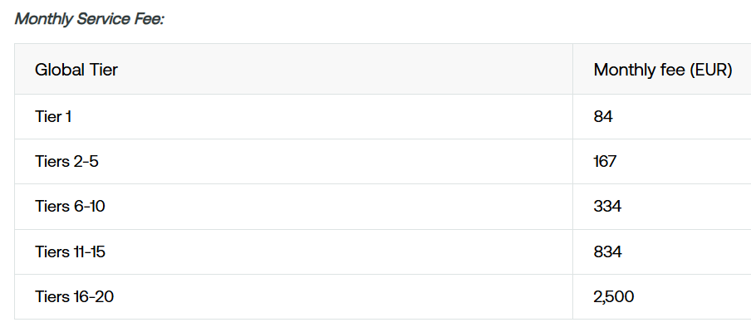
In-flow translation services for ISO20022 receivers
In-flow Translation will become chargeable for payment instruction messages as from January 2026, with charges automatically applied. Users that do not depend on In-flow Translation must opt out of the service before mid December 2025 to avoid being charged. Fees are charged at the level of the receiving 8-character BIC on a monthly basis.
The messages in scope are listed in KB Article 6000054. Receiving BICs will be charged if in scope messages are translated by the In-flow Translation service in the month.
The charge per BIC is the monthly service fee based on Global Tier.
The fees are not included in the Fixed fee or Swift Essentials.
Monthly usage fee: No usage fees are applicable. Fees may be introduced in the future.

Slide 7
Testing the FIN validation rules and contingency processing (1/2)
Information on the availability date of the SR 2025 content on the FIN Test and Training and FINplus pilot environments is available on the Standards Releases page https://www.swift.com/standards/standards-releases
On 19 July 2025, SR2025 is activated in FIN future mode (without the additional contingency FIN validation rules).
On 26 July 2025, the additional contingency FIN validation rules are activated and customers who wish to test both these FIN validation rules and contingency processing can start their tests.
A Test Sparring Partner (TSP) catalogue to test the Contingency processing is currently under evaluation. Starting mid-July access to the testing environment will be available.
For Senders:
Purpose: validate that MTs sent after Nov 2025 are compliant with the new contingency FIN validation and that MTs are properly translated to ISO 20022
Configure a FINplus test reception queue in your interface and open the SwiftNet connection to that queue
Send MT payment instructions to your own BIC on FIN Test and Training with the LT logged-in in future mode
Validate processing: the MT message shall be ACKed and be sent for contingency processing
Reception: the ISO 20022 equivalent message will be delivered to your BIC DN over the FINplus pilot future service on the SwiftNet queue that you have configured
In the event of a FIN NAK, the error codes related to the contingency validation and processing will be listed in the corresponding documentation on the Standards Release Guide page

Slide 8
Testing the FIN validation rules and contingency processing (2/2)
For Receivers:
Purpose: confirm that the MT messages sent by your clients after Nov 2025 are properly translated and the received ISO 20022 can be processed in your downstream systems (if In-flow translation is activated, the embedded MT will also be delivered with the ISO 20022)
Contact a few clients you would like to test with and organize a test window
Configure a FINplus test reception queue in your interface and open the SwiftNet connection to that queue
Ask your clients to send MT payment instructions to your BIC on FIN Test and Training with the LT logged-in in future mode
Reception: the ISO 20022 equivalent message will be delivered to your BIC DN over the FINplus pilot future service on the SwiftNet queue that you have configured
The received ISO 20022 contains a flag indicating that Swift has converted the source MT (see the flag documentation in your interface)
If the receiver is opt-in to In-flow translation for this ISO 20022 message, an embedded MT will also be delivered with the ISO 20022. This MT is generated by In-flow translation based on the content of the ISO 20022
Confirm that you have successfully processed the inbound ISO 20022 (or embedded MT) in your downstream systems

Slide 9
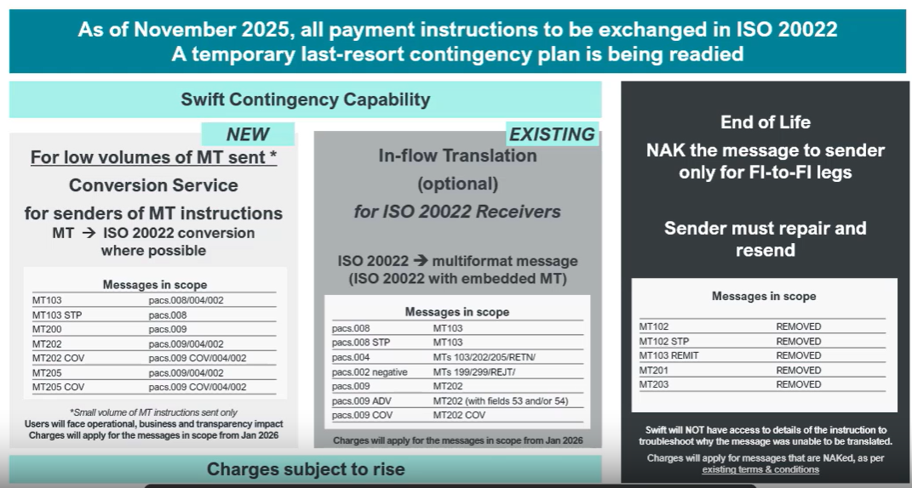
Additional information
Swift Smart: Course and Class Details (8 minute webinar)

Slide 10
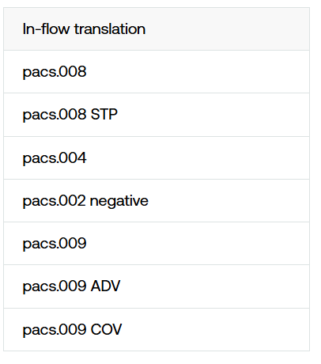
The following table lists the messages in scope of In-flow translation for contingency processing (ISO 20022 to MT translation embedded in multi-format):
Note: The complete list of messages processed by In-flow translation is available in Appendix A of In-flow Translation Service Overview. https://www2.swift.com/go/book/book201414

Slide 11
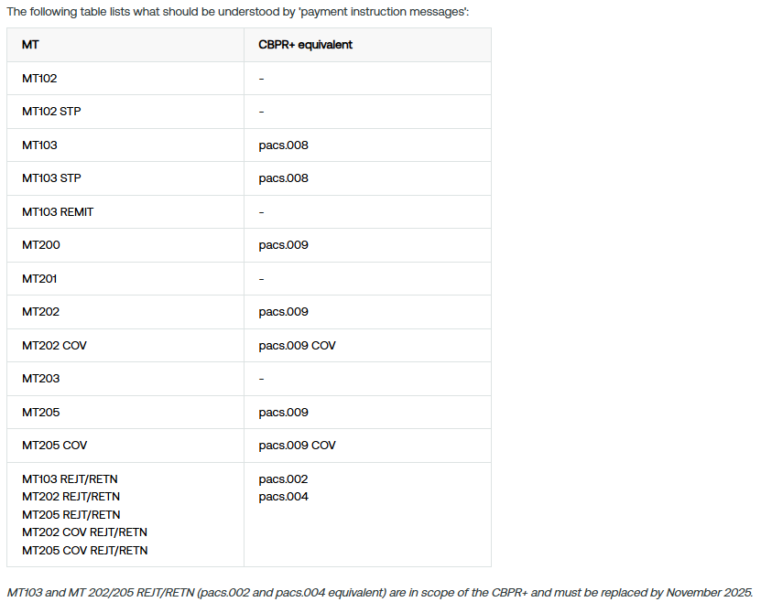
MT103 and MT 202/205 REJT/RETN (pacs.002 and pacs.004 equivalent) are in scope of the CBPR+ and must be replaced by November 2025.

Slide 12
Note on MT101 Request for Transfer [Update January 2025]
Following community consultation and feedback regarding MT101 (interbank), the switch to the ISO 20022 equivalent (pain.001) will be deprioritized for November 2025.
Swift will consult with the community to support pain.001 adoption and will communicate an updated plan in the second half of 2025.
In the interim, MT101 (single instruction FI-to-FI) and MT 101 (multiple instruction FI-to-FI) will continue to be supported on FIN after November 2025.
Conversion processing of MT 101 (single instruction FI-to-FI) is no longer required at this stage, and In-flow translation will support pain.001 interbank to MT 101 from November 2025.
Further information can be found in KB article 5026117.

Slide 13
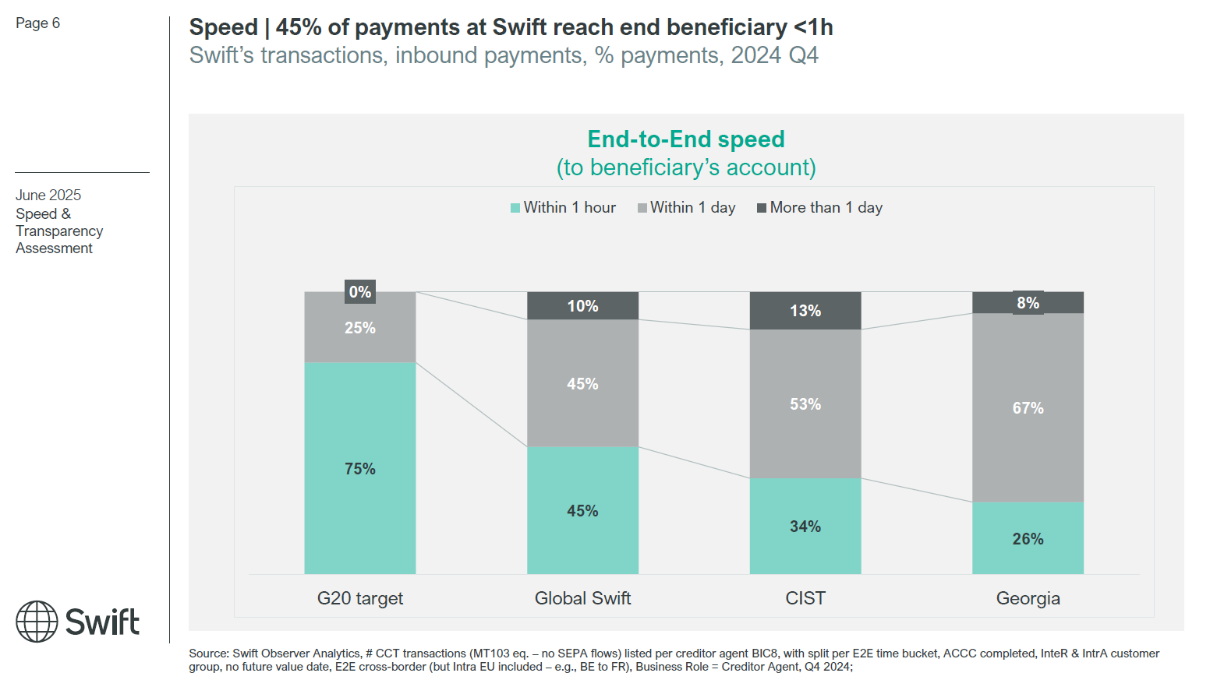
Market Assessment G20 – speed of payments

